Slide 1
Cysteine Prediction in Pea Cultivars Using Raman Spectroscopy and Machine Learning
Priyanshu Mittal
June 17, 2026

Slide 2
What We Did This Week?
Completed a second round of literature review (6 papers)
Trained and optimised a PLSR model as the baseline
Tested 8 different preprocessing combinations
Compared two validation strategies: 80/20 split and Leave-One-Cultivar-Out (LOCOCV)

Slide 3
Literature Review Summary
Paper | Method | Key Contribution
Wu et al. 2025 | Preprocessing Ensemble (PFCOVSC) | Combines multiple preprocessing methods into one fused matrix, outperforming any single method by up to 49%
Liu et al. 2024 | Deep Learning Review | Covers autoencoders, transfer learning, data augmentation, all relevant for small datasets
Wang et al. 2024 | XGBoost as Preprocessor | Uses XGBoost to transform spectral features before regression, a novel alternative to standard preprocessing
Chen et al. 2023 | Gaussian Process Regression | GPR provides prediction plus confidence interval, useful for flagging unreliable predictions on unseen samples
Xiao et al. 2025 | Deep Learning on Pea Protein | Same crop as the SERS study, uses Vis-NIR plus deep learning for combined prediction and classification
Yang et al. 2024 | DNN with NIR Spectroscopy | Demonstrates non-destructive protein prediction through rice husks using a five-layer DNN, outperforming PLSR and SVR
Notes:
Preprocessing ensembles combining multiple preprocessing methods (SNV + MSC + derivatives) into one fused matrix extracts complementary information no single method captures
Autoencoder + regression unsupervised spectral feature extraction followed by regression, handles small datasets better than end-to-end supervised models
Transfer Learning — pretrain CNN on large spectral dataset, fine-tune on our 20-cultivar dataset, directly addresses the small dataset limitation
XGBoost as preprocessing transforms spectral data into binary feature vectors before regression, shown to outperform SNV/MSC/derivatives on Raman data
Gaussian Process Regression (GPR) provides uncertainty estimates per prediction, particularly useful under LOCO where unseen cultivars may produce unreliable results
General Deep Learning Model (Pea-specific) predicts and classifies pea protein content simultaneously using Vis-NIR spectroscopy, directly applicable to our pea cultivar dataset
Deep Neural Network (DNN) five-layer fully connected network, outperformed both PLSR and SVR for protein prediction through NIR spectroscopy

Slide 4
Dataset Overview - Updated
20 pea cultivars × 324 spectra = 6,480 spectra total
1,530 usable spectral data points per spectrum
Raman shift range: 97.8 – 3,361.7 cm⁻¹
Cysteine range: 0.312 – 0.373 g/100g (spread of only 0.061)
Labels: one cysteine value per cultivar shared across all 324 spectra
Redbat 88 dataset updated and confirmed at 324 spectra

Slide 5
PLSR – Partial Least Squares Regression
Introduction:
Standard baseline model for spectroscopy
Designed specifically for high-dimensional data like spectra where we have many features more than samples
What it does:
Compresses 1530 spectral features into a small number of latent components
Raw Spectrum
1
PLSR
2
18 Components
3
Cysteine Prediction

Slide 6
Preprocessing Pipeline
Raw Spectrum
SG Smoothing
SNV
PLSR
Prediction
Step 1 — Savitzky-Golay Smoothing (applied to all) Reduces high-frequency noise while preserving peak shape.
Window = 11, polynomial order = 3.
Step 2 — Normalisation/Correction (varied)
Eight combinations tested: SG + SNV, SG + MSC, SG + 1st Derivative, SG + 2nd Derivative, SG + SNV + 1st Der, SG + SNV + 2nd Der, SG + MSC + 1st Der and SG + MSC + 2nd Der
Notes:
SG + SNV: Removes intensity scaling differences and normalizes spectra.
SG + MSC: Corrects multiplicative scatter effects caused by particle size or light scattering.
SG + 1st Derivative: Removes baseline shifts and enhances peak resolution.
SG + 2nd Derivative: Provides stronger baseline correction
SG + SNV + 1st Derivative: Normalizes spectra and enhances peak features while reducing baseline effects.
SG + SNV + 2nd Derivative: Normalizes spectra and provides stronger enhancement of spectral features with improved baseline removal.
SG + MSC + 1st Derivative: Corrects scatter effects and enhances peak resolution.
SG + MSC + 2nd Derivative: Corrects scatter effects and provides stronger baseline removal and peak separation.

Slide 7
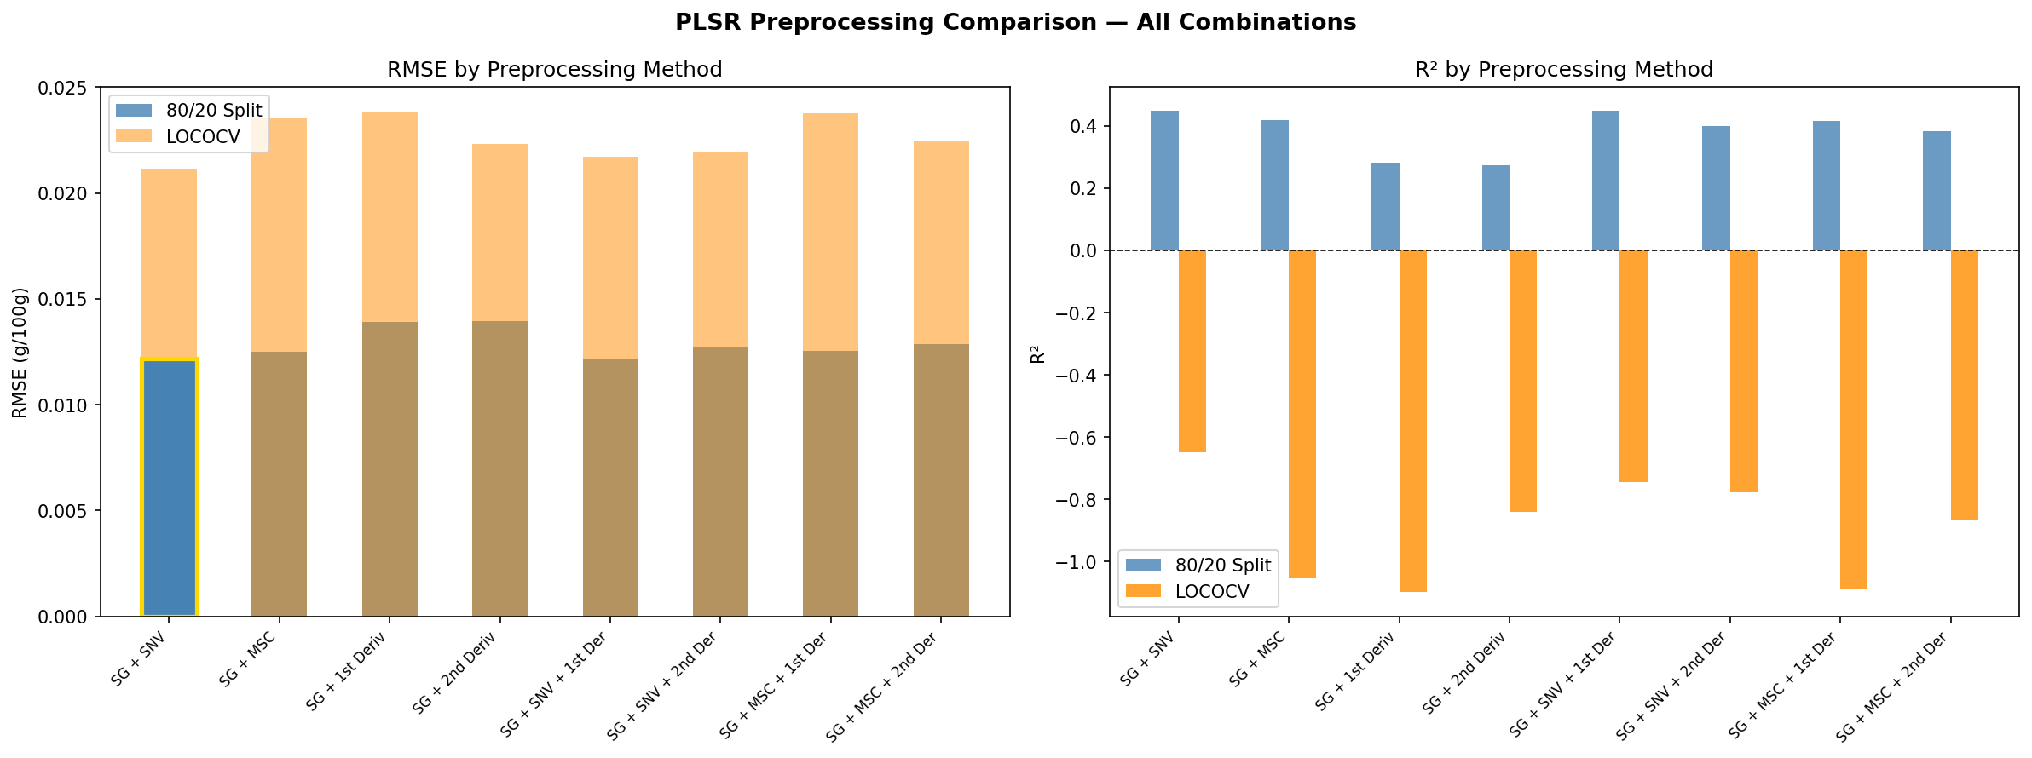
Preprocessing Optimization Results

Slide 8
Preprocessing Method | Best Components | 80/20 RMSE | 80/20 R² | 80/20 RPD | LOCO RMSE | LOCO R² | LOCO RPD
SG + SNV | 18 | 0.0122 | 0.4476 | 1.3455 | 0.0211 | -0.6481 | 0.7790
SG + MSC | 18 | 0.0125 | 0.4182 | 1.3111 | 0.0236 | -1.0547 | 0.6976
SG + 1st Derivative | 30 | 0.0139 | 0.2811 | 1.1794 | 0.0238 | -1.0987 | 0.6903
SG + 2nd Derivative | 25 | 0.0140 | 0.2730 | 1.1729 | 0.0223 | -0.8413 | 0.7369
SG + SNV + 1st Derivative | 30 | 0.0122 | 0.4470 | 1.3447 | 0.0217 | -0.7433 | 0.7574
SG + SNV + 2nd Derivative | 30 | 0.0127 | 0.3989 | 1.2898 | 0.0219 | -0.7762 | 0.7503
SG + MSC + 1st Derivative | 28 | 0.0125 | 0.4154 | 1.3079 | 0.0238 | -1.0876 | 0.6921
SG + MSC + 2nd Derivative | 27 | 0.0129 | 0.3832 | 1.2733 | 0.0225 | -0.8643 | 0.7324
Notes:
Among all preprocessing combinations,
SG + SNV produced the strongest overall performance, achieving the highest R² and RPD values and the lowest RMSE for both the 80/20 split and LOCO validation.
Derivative hurts performance: adding 1st or 2nd derivative made results worse across all combinations. Likely because the cysteine signal is very subtle and derivatives amplify noise alongside real signal
MSC performs similarly to SNV but slightly worse
The gap between 80/20 and LOCO is consistent across all 8 methods, no preprocessing combination closes it. This indicates the limitation is the model itself, not the preprocessing

Slide 9
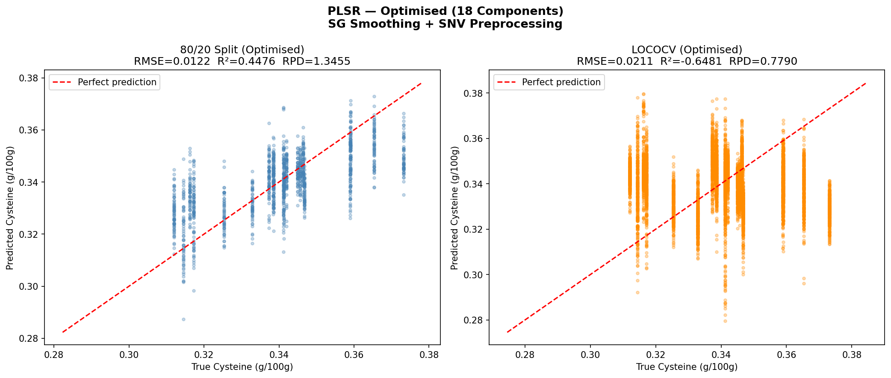
PLSR Results
 | 80/20 Split | LOCOCV
RMSE | 0.0122 | 0.0211
R² | 0.4476 | -0.6481
RPD | 1.3455 | 0.7790
Notes:
80/20 Split (R² = 0.45, RPD = 1.35)
Moderate performance
RPD < 2.0 is not sufficient for screening applications
LOCOCV (R² = -0.65, RPD = 0.78)
Negative R² model predicts global mean (~0.34) for every sample

Slide 10
80/20 vs LOCOCV
80/20 Split | LOCOCV
Model sees all cultivars during training Artificially inflated performance | Model tested on completely unseen cultivar Exposes true generalisation ability PLSR predicts global mean (~0.34) for every unseen cultivar

Slide 11
Derived vs Published Results
 | Research Paper | Derived Paper
Preprocessing | SG + ModPoly + Min-Max | SG + SNV
Components | 25 | 18
LOCO RMSE | 0.021 | 0.0211
Within-cultivar R² | 0.626 | 0.4476

Slide 12
Conclusion
Best preprocessing: SG + SNV outperformed all 8 combinations on both validation strategies
PLSR baseline: Moderate performance on 80/20 (R²=0.45) but poor generalisation under LOCO (R²=-0.65)
Key challenge: Narrow cysteine range (0.061 g/100g) and high within-cultivar variability limit PLSR generalisation

